Slide 1
News Article(Text, Image) Sentiment Analysis

Slide 2
CONTENTS
Sentiment Analysis
Tools
Code
Sentiment Analysis of Text
Sentiment Analysis of Image
Conclusion

Slide 3
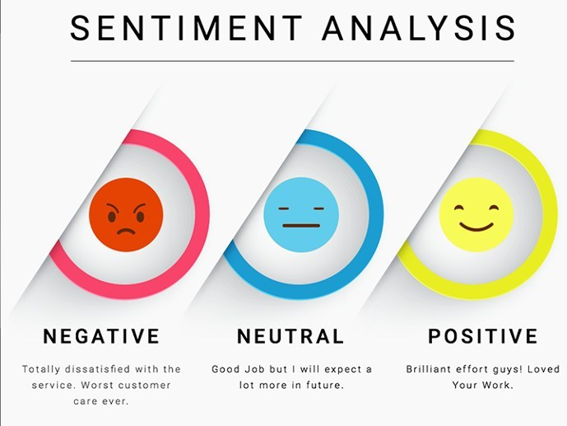
Sentiment Analysis
What is the Sentiment Analysis?
The process of determining the emotional tone behind a series of words
Used to gain an understanding of the attitudes, opinions and emotions expressed within an online mention
Extremely useful in social media monitoring

Slide 4


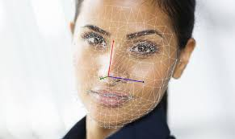
Outline of Sentiment Analysis
Text
News
Image
Using article’s abstract
Do Sentiment Analysis based on abstract
Analyze based on 4 categories
Figuring out the most positive news
Figuring out the most Negative news
Finding News
Positive
negative
To confirm text analysis
Using news image and confirm result
by image analysis
Comparing results from
Text & Image Sentiment Analysis

Slide 5

Sentiment Analysis
The purpose of Sentiment Analysis
To find out the reaction from users related to specific person or subject
How we can get data?
Most of article from May to August in 2019
On the Main page
Using 4 Category
Politics
Money
Sports
Entertainment

Slide 6


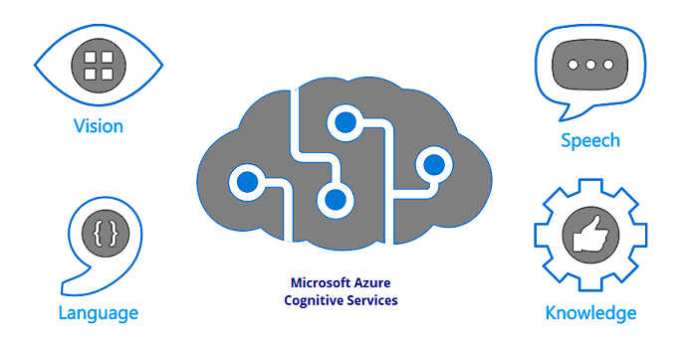

Tools

Slide 7
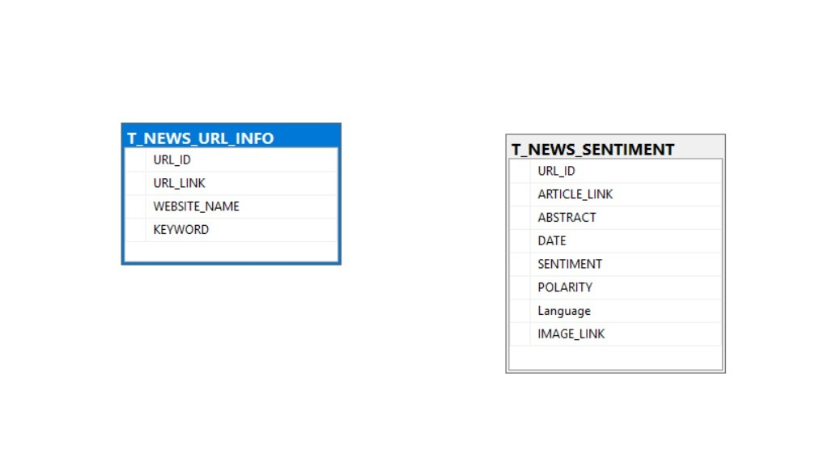
Data Model

Slide 8
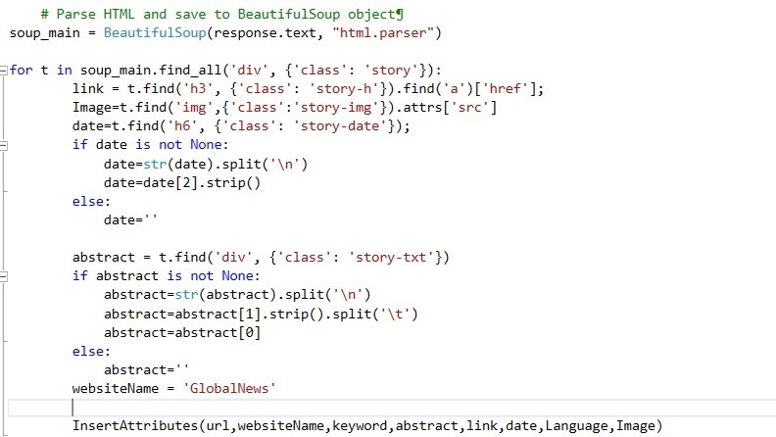
Code – Snippet 1
Getting the Data from
‘The Globe’ news

Slide 9
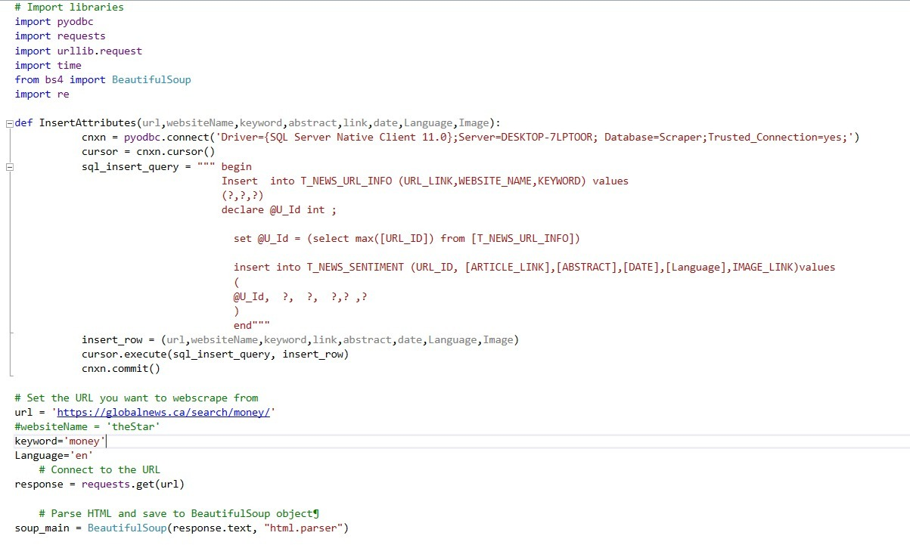
Code – Snippet 2
Insert Data to Database

Slide 10
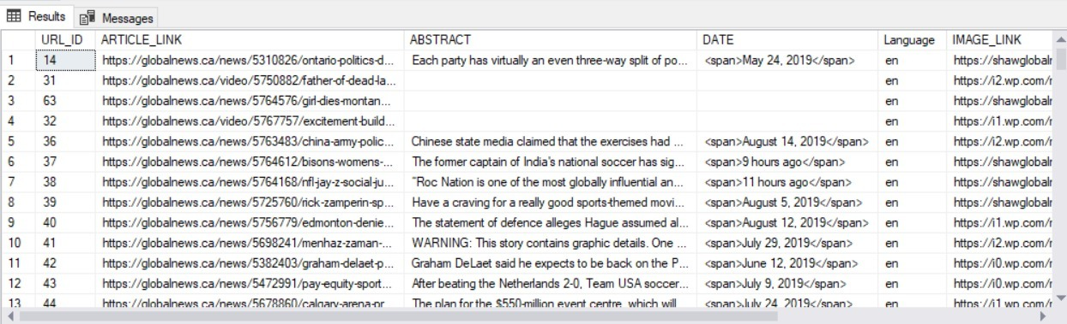
Data Tables

Slide 11
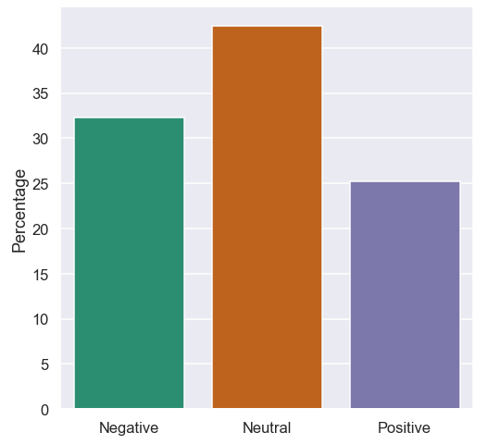
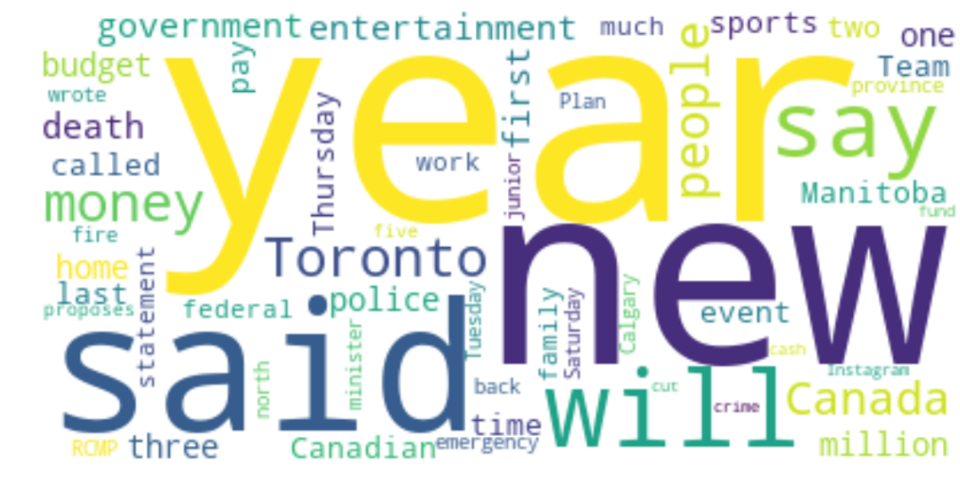
Sentiment Analysis of Text
Analysis of articles
Most of articles are Neutral
Negative is slightly more than positive

Slide 12

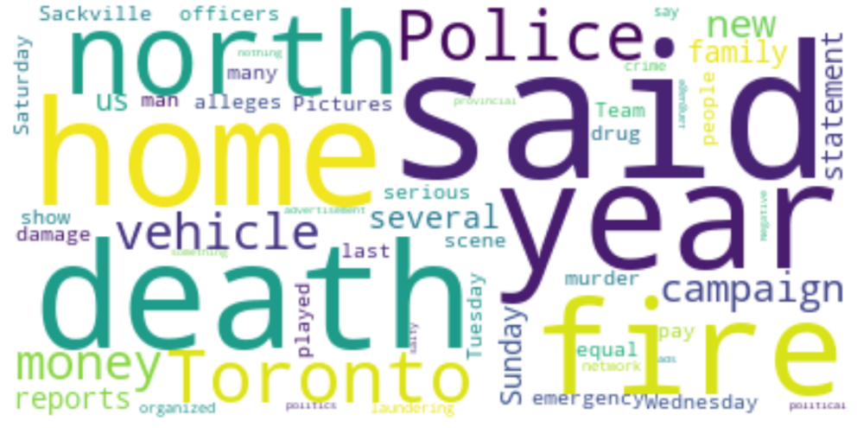
Sentiment Analysis of Text
Positive VS Negative

Slide 13
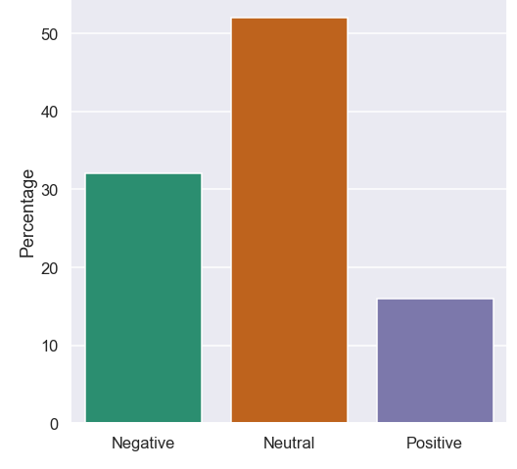
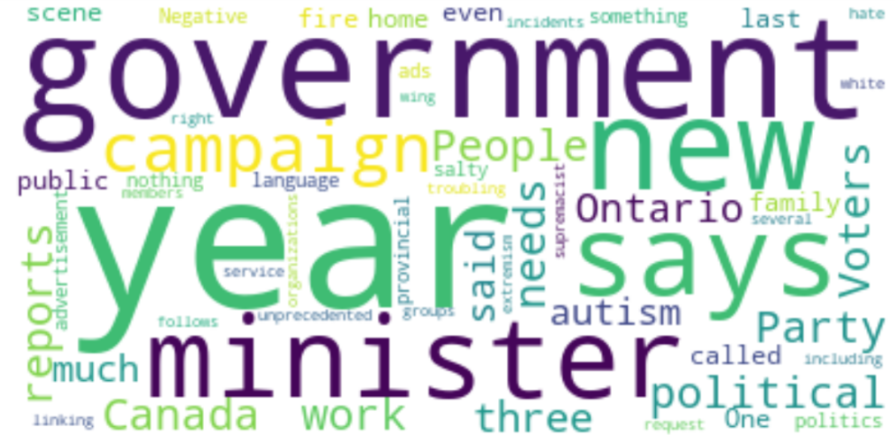
Sentiment Analysis of Text
1) Politics

Slide 14
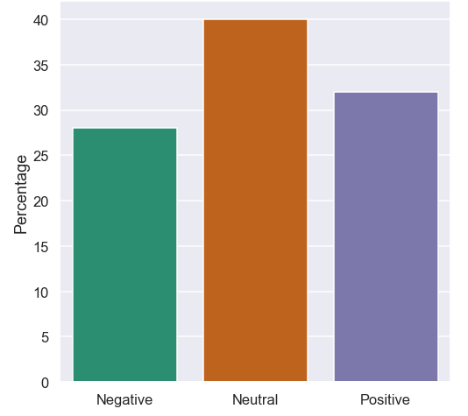

Sentiment Analysis of Text
2) Money

Slide 15
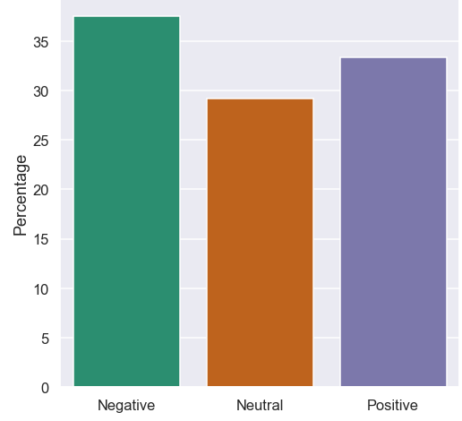
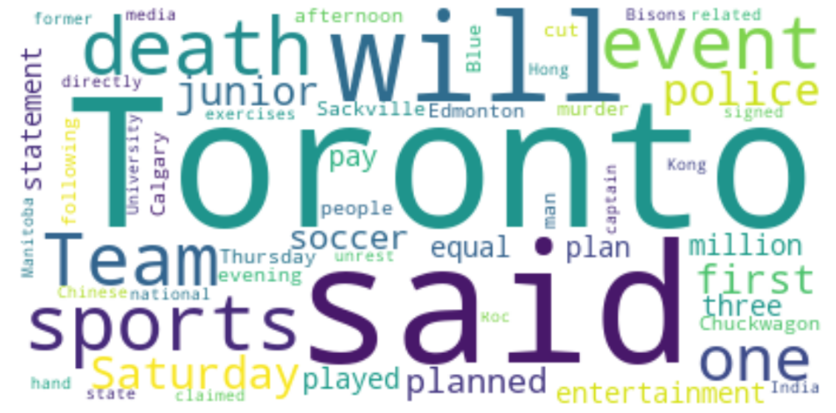
Sentiment Analysis of Text
3) Sports

Slide 16
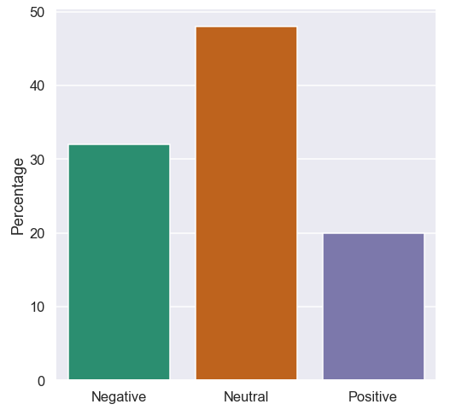
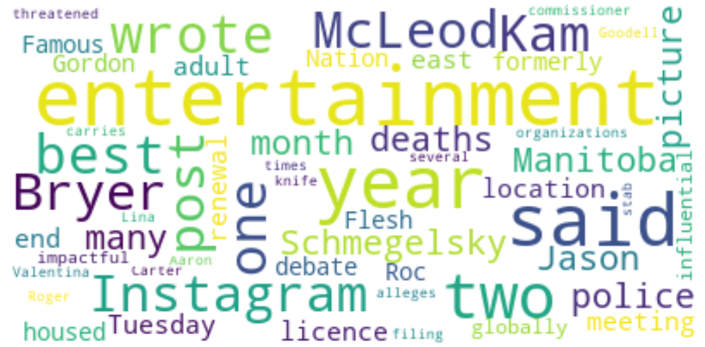
Sentiment Analysis of Text
4) Entertainment

Slide 17
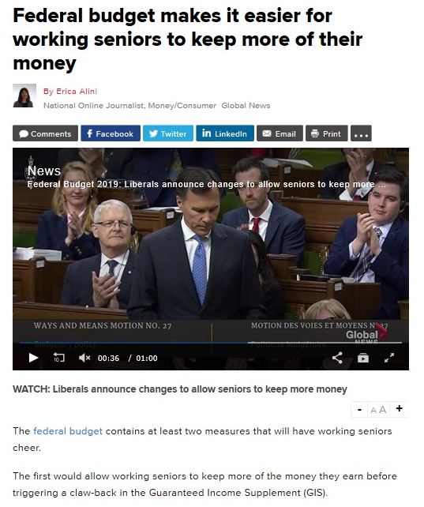
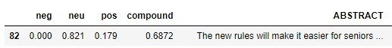
Sentiment Analysis of Image 1. Positive News
1) The most ‘Positive’ News
News in Reality
Positive News from the result of Text Analysis

Slide 18
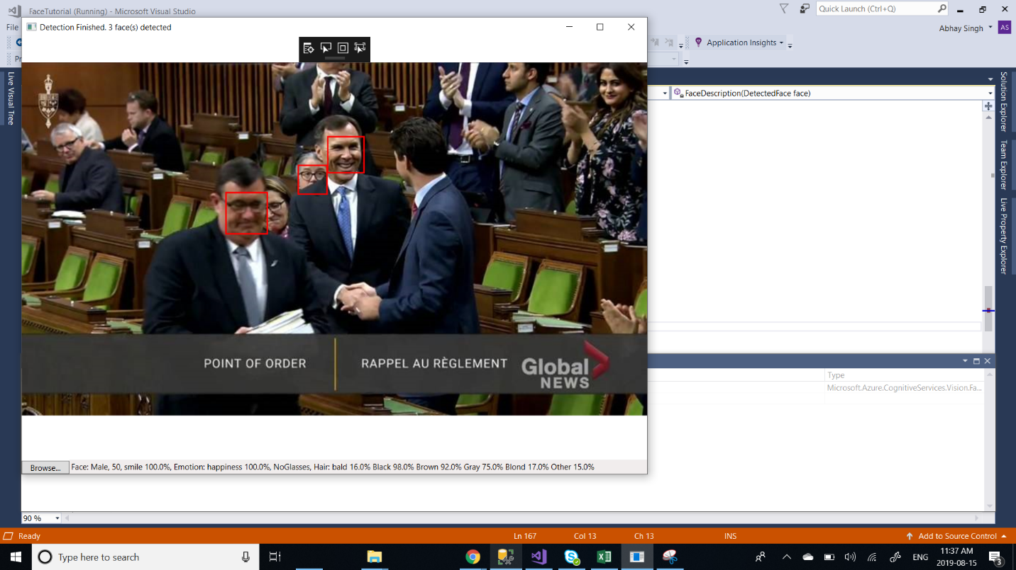

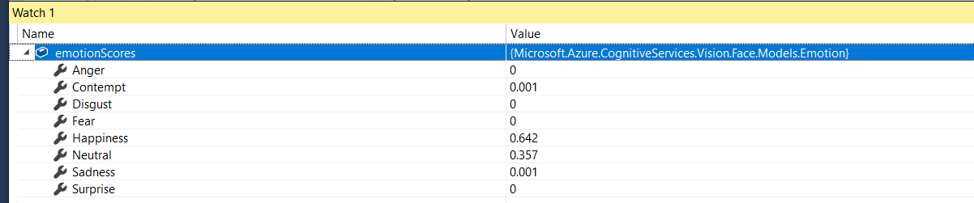
Sentiment Analysis of Image 1. Positive News
2) Image Analysis from Positive News
Face detection result from the API

Slide 19
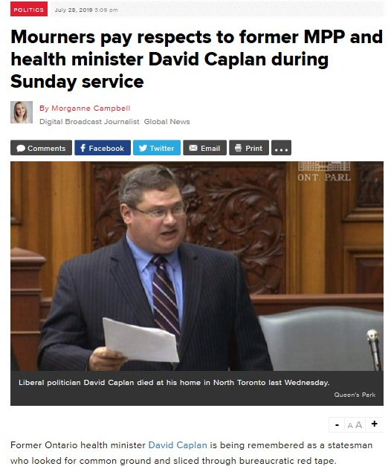
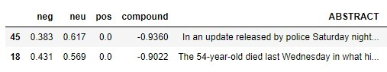
Sentiment Analysis of Image 2. Negative News
1) The most ‘Negative’ News
News in Reality
Negative News from the result of Text Analysis

Slide 20
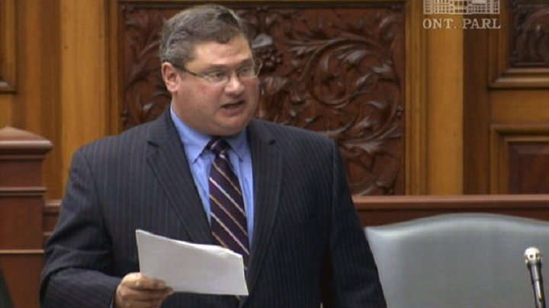
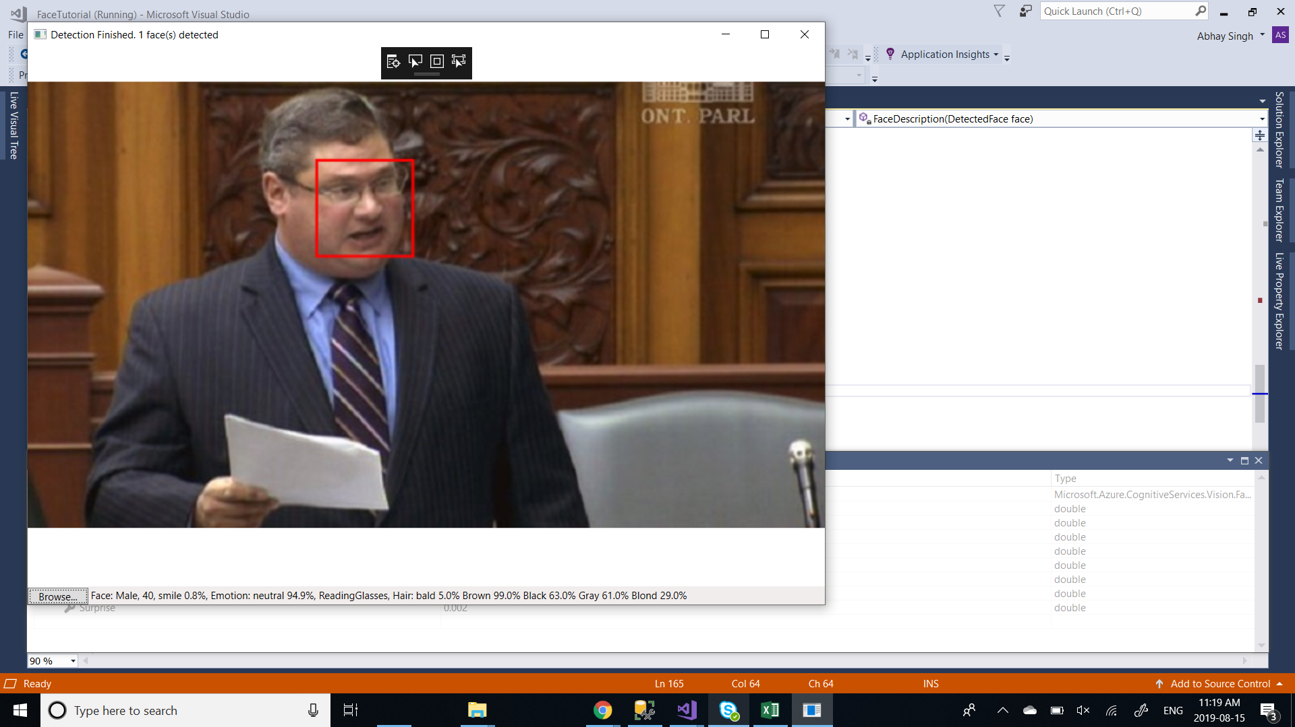
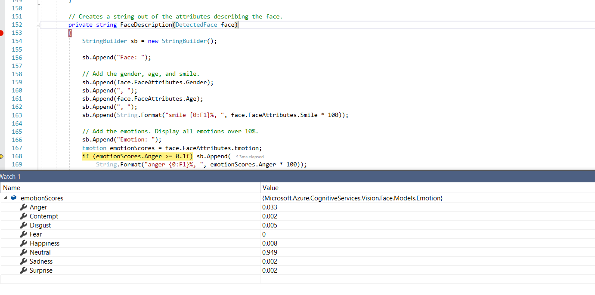
Sentiment Analysis of Image 2. Negative News
2) Image Analysis from Negative News
Face detection result from the API

Slide 21
Conclusion
Text and Image Analysis
Each one works well, and the results are matched each other
The drawbacks of Image Analysis
It is difficult to analyze exactly because it will be different according to the angel and moments of image
Only working for human face

Slide 22
Q&A

Slide 23
Thank you
End of Document
BIZFORMS

